Slide 1
Lecture 2 Python Basic
Jaeyun Kang

Slide 2
Python Basic – Function
def <function_name> (<parameter_name>):
statement1
statement2
…
def sum(a, b):
return a + b
print (sum(3, 4)) // 7

Slide 3
Python Basic – Function
def sum(a, b):
result = a + b
return result
a = sum(3, 4)
print (a) // 7

Slide 4
Python Basic – Function
def sum(a, b):
print (a + b)
sum(3, 4) // 7
a = sum(3, 4)
print (a) // none

Slide 5
Python Basic – Function
def say():
return ‘Hi’
a = say()
print (a) // Hi
def say():
print (‘Hi’)
say() // Hi

Slide 6
Python Basic – Function
def sum_and_mul(a, b):
return a+b, a*b
a = sum_and_mul(3, 4) // a = (7, 12)
sum, mul = sum_and_mul(3, 4) // sum=7, mul=12
def sum_and_mul(a, b):
return a+b
return a*b
a = sum_and_mul(3, 4) // a = 7

Slide 7
Python Basic – Function
def say_nick(nick):
if nick == “바보”:
return
print(“나의 별명은 %s입니다.” %nick)
say_nick(‘야호‘) // 나의 별명은 야호입니다.
say_nick(‘바보‘) // nothing

Slide 8
Python Basic – Function
def say_myself(name, old, man = True):
print(“나의 이름은 %s 입니다.” % name)
print(“나의 이름은 %d살입니다.” % old)
if man:
print(“남자입니다”)
else:
print(“여자입니다“)
say_myself(“박응용”, 27)
say_myself(“박응용”, 27, True)
// 나의 이름은 박응용입니다.
// 나이는 27살입니다.
// 남자입니다.

Slide 9
Python Basic – Function
def say_myself(name, old, man = True):
print(“나의 이름은 %s 입니다.” % name)
print(“나의 이름은 %d살입니다.” % old)
if man:
print(“남자입니다”)
else:
print(“여자입니다“)
say_myself(“박응선”, 27, False)
// 나의 이름은 박응선입니다.
// 나이는 27살입니다.
// 여자입니다.

Slide 10
Python Basic – Function
def say_myself(name, man = True, old):
print(“나의 이름은 %s 입니다.” % name)
print(“나의 이름은 %d살입니다.” % old)
if man:
print(“남자입니다”)
else:
print(“여자입니다“)
say_myself(“박응용”, 27) // error

Slide 11
Python Basic – Function
a = 1
def vartest(a):
a = a + 1
vartest(a)
print(a) // 1
def vartest(hello):
hello = hello + 1

Slide 12
Python Basic – Function
a = 1
def vartest(a):
a = a + 1
return a
a = vartest(a)
print(a) // 2

Slide 13
Exercise
1. Make function which calculates and returns an average of three numbers
avg(1, 2, 3) should return 2
print (avg(1, 2, 3)) // 2
2. Make function which calculates n factorial
fact(4) should return 24
print (fact(4)) // 24

Slide 14
Python Basic – Read and Write
# writedata.py
f = open(“새파일.txt”, ‘w’)
f.close()
‘r’: reading mode
‘w’: writing mode
‘a’: appending mode

Slide 15
Python Basic – Read and Write
f = open("C:/Python/새파일.txt", 'w’)
for i in range(1, 11):
data = "%d번째 줄입니다.\n" % i
f.write(data)
f.close()

Slide 16
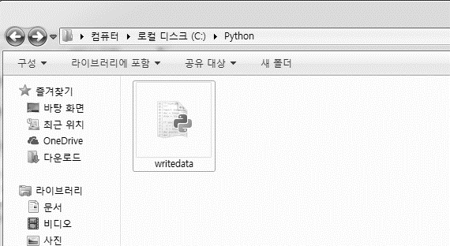
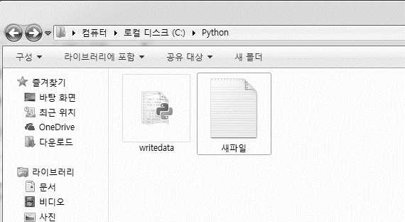
Python Basic – Read and Write
writedata.py
실행

Slide 17
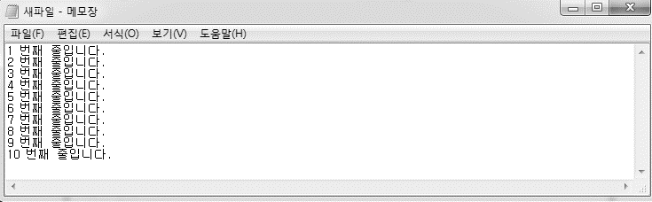
Python Basic – Read and Write

Slide 18
Python Basic – Read and Write
f = open("C:/Python/새파일.txt", 'r’)
while True:
line = f.readline()
if not line: break
print(line)
f.close()

Slide 19
Python Basic – Read and Write
f = open("C:/Python/새파일.txt", 'r’)
lines = f.readlines()
for line in lines:
print(line)
f.close()
f = open("C:/Python/새파일.txt", 'r’)
data = f.read()
print(data)
f.close()

Slide 20
Python Basic – Read and Write
f = open("C:/Python/새파일.txt",'a’)
for i in range(11, 20):
data = "%d번째 줄입니다.\n" % i
f.write(data)
f.close()

Slide 21
Python Basic – Read and Write
f = open("foo.txt", 'w’)
f.write("Life is too short, you need python")
f.close()
with open("foo.txt", "w") as f:
f.write("Life is too short, you need python")

Slide 22
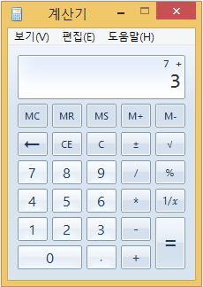
Python Basic – Class
계산기
1. 사칙연산 함수가 정의되어 있어야 한다.
2. 이전에 계산된 결과값을 기억하고 있어야 한다.

Slide 23
Python Basic – Class
result = 0
def adder(num):
global result
result += num
return result
print(adder(3)) // 3
print(adder(4)) // 7

Slide 24
Python Basic – Class
result1 = 0
result2 = 0
def adder1(num):
global result1
result1 += num
return result1
def adder2(num):
global result2
result2 += num
return result2
print(adder1(3)) // 3
print(adder1(4)) // 7
print(adder2(3)) // 3
print(adder2(7)) // 10

Slide 25
Python Basic – Class
class Calculator:
def __init__(self):
self.result = 0
def adder(self, num):
self.result += num
return self.result
cal1 = Calculator()
cal2 = Calculator()
print(cal1.adder(3)) // 3
print(cal1.adder(4)) // 7
print(cal2.adder(3)) // 3
print(cal2.adder(7)) // 10

Slide 26
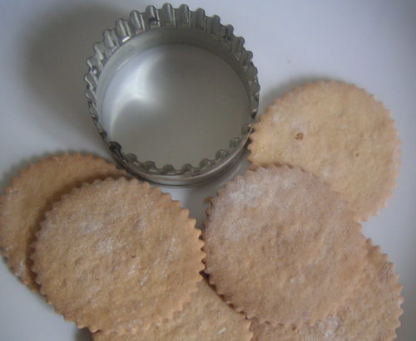
Python Basic – Class
Class & Object (클래스와 객체)
Class
Object
Object
Object

Slide 27
Python Basic – Class
class Programmer:
pass
kim = Programmer()
park = Programmer()
*kim 은 Programmer Class의 Instance
*kim 은 Object

Slide 28
Python Basic – Class
class Service:
secret = "영구는 외계인이다.“
pey = Service()
print(pey.secret) // “영구는 외계인이다.”

Slide 29
Python Basic – Class
class Service:
secret = "영구는 외계인이다."
def sum(self, a, b):
result = a + b
print("%s + %s = %s입니다." % (a, b, result))
pey = Service()
pey.sum(1,1) // 1 + 1 = 2입니다.

Slide 30
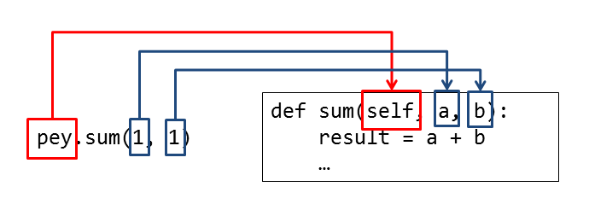
Python Basic – Class
class Service:
secret = "영구는 외계인이다."
def sum(self, a, b):
result = a + b
print("%s + %s = %s입니다." % (a, b, result))
pey = Service()
pey.sum(1,1) // 1 + 1 = 2입니다.

Slide 31
Python Basic – Class
class Service:
secret = "영구는 외계인이다."
def setname(self, name):
self.name = name
def sum(self, a, b):
result = a + b
print("%s님 %s + %s = %s입니다." % (self.name, a, b, result))
pey = Service()
pey.setname("홍길동") // pey.name = name, pey.name = "홍길동"
pey.sum(1, 1) // 홍길동님 1 + 1 = 2입니다.

Slide 32
Python Basic – Class
babo = Service()
babo.sum(1, 1) ???
class Service:
secret = "영구는 외계인이다."
def __init__(self, name):
self.name = name
def sum(self, a, b):
result = a + b
print("%s님 %s + %s = %s입니다." % (self.name, a, b, result))
pey = Service("홍길동")
pey.sum(1, 1) // 홍길동님 1 + 1 = 2입니다.

Slide 33
Python Basic – Class
class ClassName[(Inherit ClassName)]:
<Class Variable 1>
<Class Variable 2>
...
def Method1(self[, arg1, arg2,,,]):
statement1
statement2
...
def Method2(self[, arg1, arg2,,,]):
statement1
statement2
...
...

Slide 34
Python Basic – Class
#사칙연산 클래스 TODO
a = FourCal()
a.setdata(4, 2)
print(a.sum()) // 6
print(a.mul()) // 8
print(a.sub()) // 2
print(a.div()) // 2

Slide 35
Python Basic – Class
class FourCal:
pass
a = FourCal()
print(type(a)) // <class '__main__.FourCal'>

Slide 36
Python Basic – Class
#TODO
a.setdata(4, 2)
class FourCal:
def setdata(self, first, second):
self.first = first
self.second = second

Slide 37
Python Basic – Class
a = FourCal()
a.setdata(4, 2)
print(a.first) // 4
print(a.second) // 2
b = FourCal()
b.setdata(3, 7)
print(b.first) // 3
print(a.first) // 4

Slide 38
Python Basic – Class
#TODO
a = FourCal()
a.setdata(4, 2)
print(a.sum()) // 6
class FourCal:
def setdata(self, first, second):
self.first = first
self.second = second
def sum(self):
result = self.first + self.second
return result

Slide 39
Python Basic – Class
class FourCal:
def setdata(self, first, second):
self.first = first
self.second = second
def sum(self):
result = self.first + self.second
return result
def mul(self):
result = self.first * self.second
return result
def sub(self):
result = self.first - self.second
return result
def div(self):
result = self.first / self.second
return result

Slide 40
Python Basic – Class
a = FourCal()
b = FourCal()
a.setdata(4, 2)
b.setdata(3, 7)
a.sum() // 6
a.mul() // 8
a.sub() // 2
a.div() // 2
b.sum() // 10
b.mul() // 21
b.sub() // -4
b.div() // 0

Slide 41
Python Basic - module
#mod1.py
def sum(a, b):
return a + b
def mul(a, b):
return a * b
import mod1
print (mod1.sum(3, 4)) // 7
print (mod1.mul(3, 4)) // 12

Slide 42
Python Basic - module
#mod1.py
def sum(a, b):
return a + b
def mul(a, b):
return a * b
import mod1 as m
print (m.sum(3, 4)) // 7
print (m.mul(3, 4)) // 12

Slide 43
Python Basic - module
#mod1.py
def sum(a, b):
return a + b
def mul(a, b):
return a * b
from mod1 import sum
print (sum(3, 4)) // 7
print (mul(3, 4)) // error

Slide 44
Python Basic - module
#mod1.py
def sum(a, b):
return a + b
def mul(a, b):
return a * b
from mod1 import sum, mul
print (sum(3, 4)) // 7
print (mul(3, 4)) // 12

Slide 45
Python Basic - module
#mod1.py
def sum(a, b):
return a + b
def mul(a, b):
return a * b
from mod1 import *
print (sum(3, 4)) // 7
print (mul(3, 4)) // 12

Slide 46
Python Basic - module
#mod1.py
def sum(a, b):
return a + b
def mul(a, b):
return a * b
print (sum(3, 4)) // 7
mod1.py 실행시 7 출력

Slide 47
Python Basic - module
#mod1.py
def sum(a, b):
return a + b
def mul(a, b):
return a * b
print (sum(3, 4)) // 7
#test.py
import mod1
test.py 실행시에도 7 출력 ?

Slide 48
Python Basic - module
#mod1.py
def sum(a, b):
return a + b
def mul(a, b):
return a * b
if __name__ == "__main__":
print (sum(3, 4)) // 7
mod1.py 실행시 7 출력 (__name__ = “main”)

Slide 49
Python Basic - module
#mod1.py
def sum(a, b):
return a + b
def mul(a, b):
return a * b
if __name__ == "__main__":
print (sum(3, 4)) // 7
#test.py
import mod1
test.py 실행시에 7 출력 x (__name__ = “mod1.py”)

Slide 50
Python Basic - module
# mod2.py
PI = 3.141592
class Math:
def solv(self, r):
return PI * (r ** 2)
def sum(a, b):
return a+b
if __name__ == "__main__":
a = Math()
print(sum(PI , 4.4))

Slide 51
Python Basic - module
import mod2
print(mod2.PI) // 3.141592
a = mod2.Math()
print(a.solv(2)) // 12.566368
print(mod2.sum(mod2.PI, 4.4)) // 7.541592

Slide 52
Question

